Slide 1
Audience, purpose, context

Slide 2
Audience, purpose, context
Every text (film, article, short story, novel, advertisement, newspaper, website, Snapchat, YouTube video, etc.) is created with a specific audience in mind. A text can be created and received in different contexts.
In the Year 11 General English course, we will be analysing and evaluating texts in regards to their intended function (by looking at the intended audience, purpose and context and how effective the text is).

Slide 3
Audience
Texts are created to appeal to a particular audience.
An audience is the group of readers, listeners or viewers that the writer, designer, filmmaker or speaker is addressing. Audience includes students in the classroom, an individual, the wider community, review writers, critics and the implied audience.

Slide 4








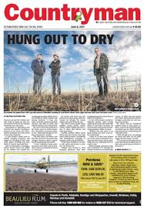
Who is the target audience?

Slide 5
Purpose
The purpose of a text is simply the writer's reason for writing. Many texts have more than one purpose, but usually one will stand out as primary. Readers have the job of determining the purpose or purposes of a text and understanding why the writer is writing and what the writer wants the reader to do with the text.
Texts may be written to entertain, instruct, persuade or inform their readers.

Slide 6
What is the purpose of these texts?
Recipe
Workplace contract
Film
TV manual
IKEA assembly instructions
TV news report
Political debate

Slide 7
Context
The environment in which a text is responded to or created. Context can include the general social, historical and cultural conditions in which a text is responded to and created (the context of culture) or the specific features of its immediate environment (context of situation).

Slide 8
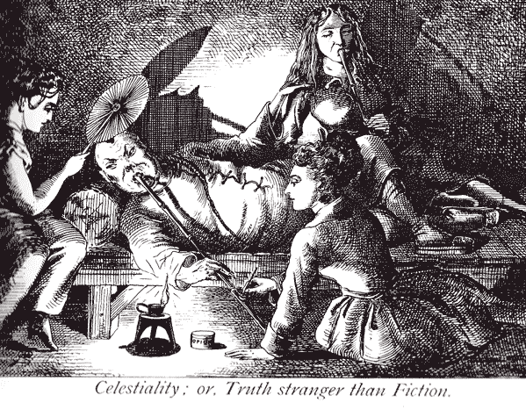
Context example:
During the gold rushes in the US and Australia, the Chinese were seen as a threat – due to their hard work ethic, it was believed they would become the ‘master race.’ The Australian government implemented the White Australia policy, and
the Chinese were depicted
in the media as inferior
(rather than superior) to
white Australians in an
effort to discredit them.

Slide 9
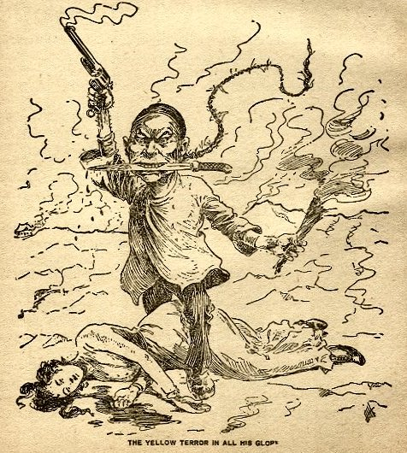
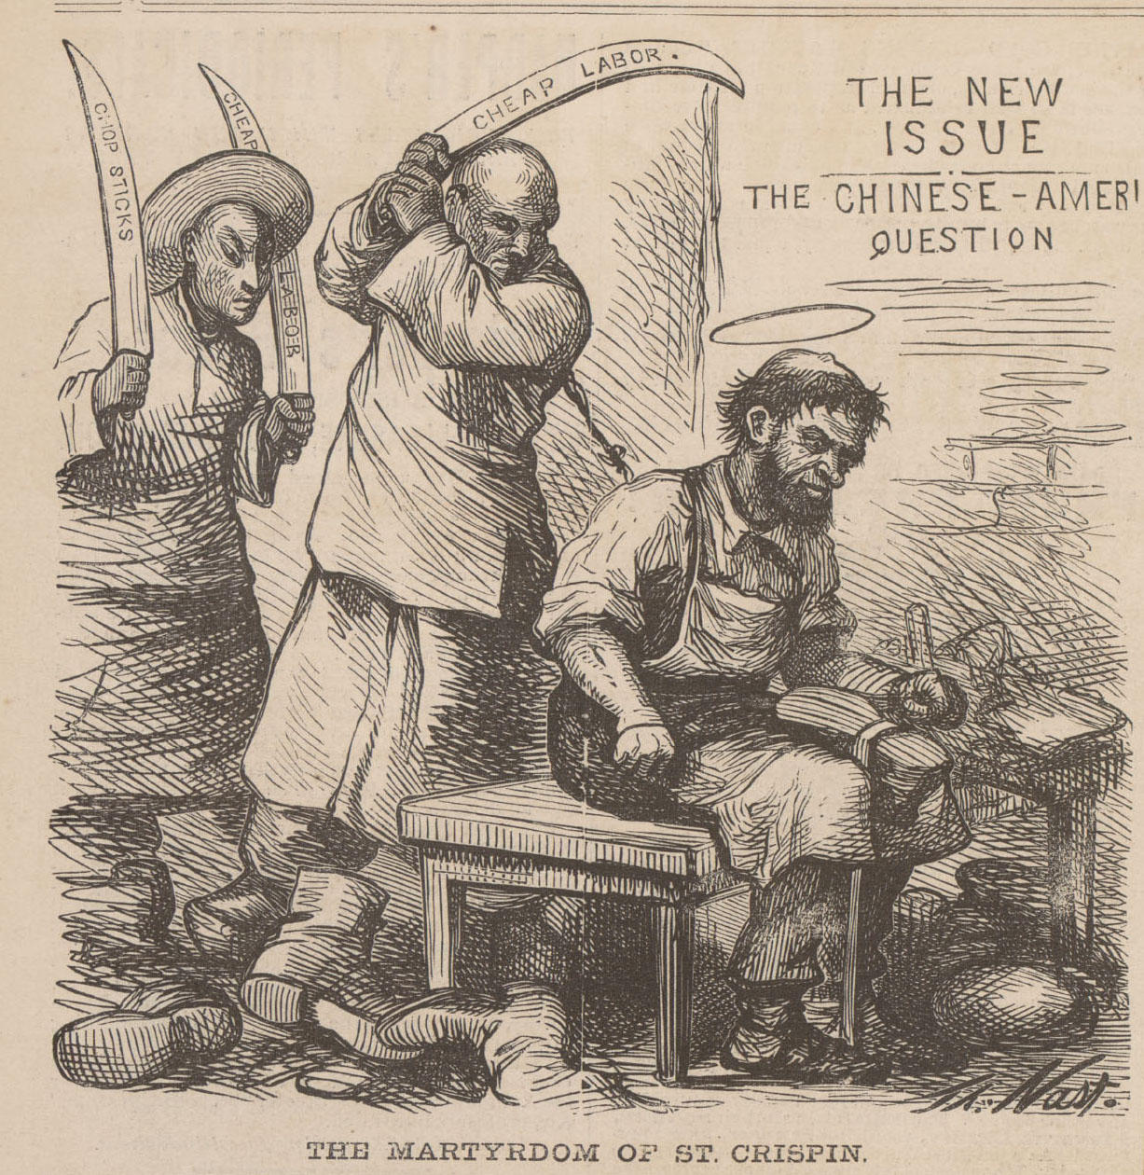
Chinese stereotypes 1890:

Slide 10
Context
As Australians living in a multicultural society, we value equality and egalitarianism. Due to our context, we would see these images as inherently racist and offensive.
However, this might not have been the case when the images were produced. Imagine the government publishing the following images today…

Slide 11
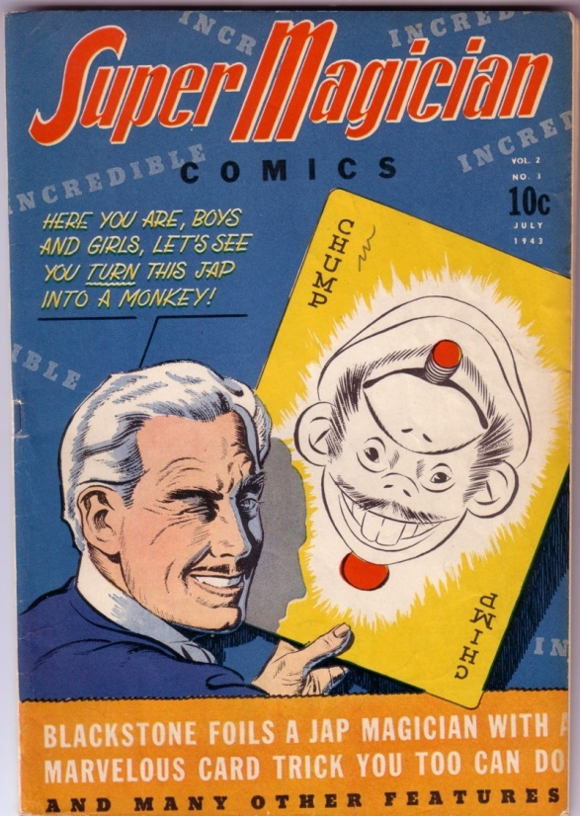
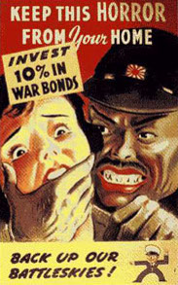
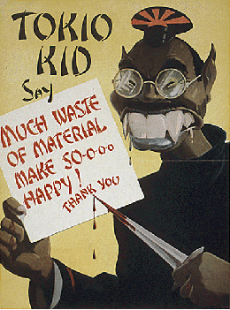
Japanese stereotypes WW2

Slide 12

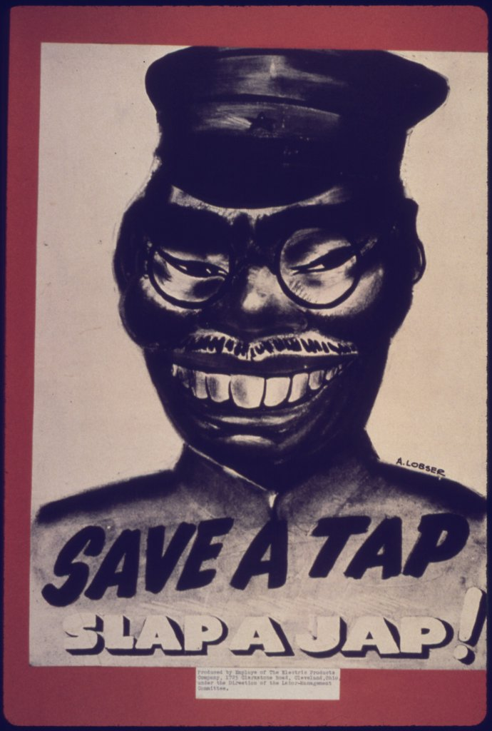
Japanese stereotypes WW2

Slide 13
Reading audience, purpose and context through different perspectives.
At first glance, we might think that a text has been successful in relation to its ability to reach its intended audience with a certain purpose in mind. One way to challenge a text’s effectiveness is by looking at it through a different perspective.

Slide 14
Perspective
A position from which things may be viewed or considered. People may have different perspectives on events or issues due to (for example) their age, gender, social position and beliefs and values.
A perspective is more than an opinion; it is a viewpoint informed by one or more contexts. While a pregnant woman, a homeless man and a police officer, for example, view the world from different perspectives, they may still share the same opinion about something. Texts through an embedded ideology can also present a particular perspective.

Slide 15
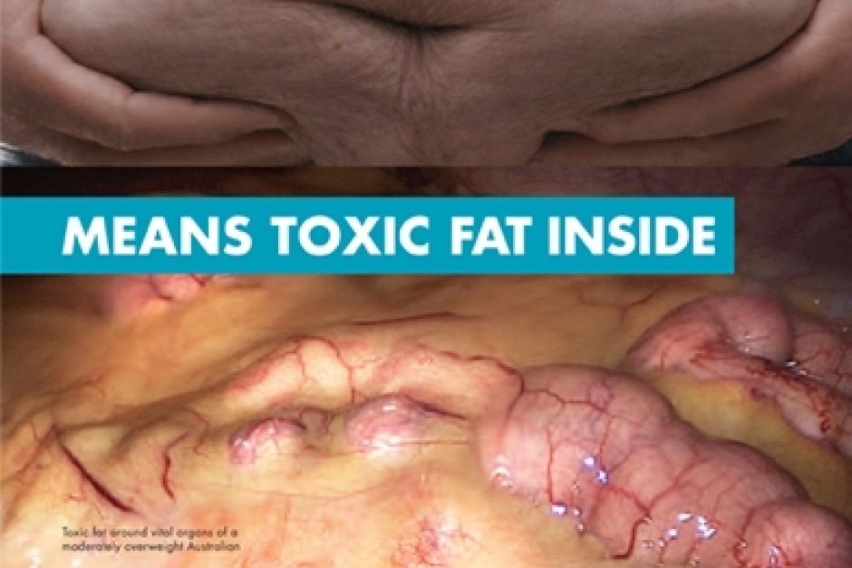
Perspectives in action

Slide 16
A doctor might have the perspective that this is a great advertisement and a healthy one. He/she values a healthy lifestyle.
An obese person viewing the advertisement might have the perspective of feeling victimised or humiliated. They may value privacy and hold the attitude that their weight is no one’s business but theirs.

Slide 17
Another obese person may hold the viewpoint that this is another stereotypical advertisement that simplifies the issue by blaming fat people for their unhealthy state. As such they value honesty and scientific truth and believe that the obesity issue is a complex one with many factors, not just people being weak-willed, leading people to become overweight or morbidly obese.
A fit thin person might have the perspective that fat people are lazy, so this person values an active lifestyle. The attitude they hold is that if overweight and obese people simply exercised, then they would lose weight, feel better and become healthier.

Slide 18
A nurse who views this advertisement might applaud it because, from their perspective, too many people who contract diabetes and end up in hospital, clog up the health system; they take beds that other people, who are ill from unpreventable or sudden causes, need. They value efficiency and healthy choices. They hold the attitude that truly sick people should be admitted to hospital; not those who could prevent their illness.
A man watching this advertisement may feel that it is unfair because it targets only men. He values equity and holds the attitude that there should also be a female version of this advert.

Slide 19
Questions to ask when viewing a website:
Who is the intended audience for this website in regards to age, gender, interests, and social demographic?
What is the intended purpose of this website – to inform, entertain, instruct, persuade?
What is the context this website was written in and how could it be received by people from different contexts?
From which perspectives could this website be seen to be effective and/or ineffective?

Slide 20
Questions to ask when viewing a website:
Reading: accessibility – would this website be accessible for migrants?
Language – does the website use Standard Australian English, persuasive, descriptive, emotive language, text speak?
What information does the website give the reader?
Is it informative, entertaining, persuasive, or instructional/educational?

Slide 21
Questions to ask when viewing a website:
Viewing: design – is the website bare, stylish, high/low visual complexity, is the website easy to access for all ages, or not?
Images – what do the images depict and who are they of? What is the intended effect on the viewer? Which groups are represented, which groups are marginalised?
Appeal – is the website visually appealing? To whom? Does the website illicit emotion or interest?

